Slide 1
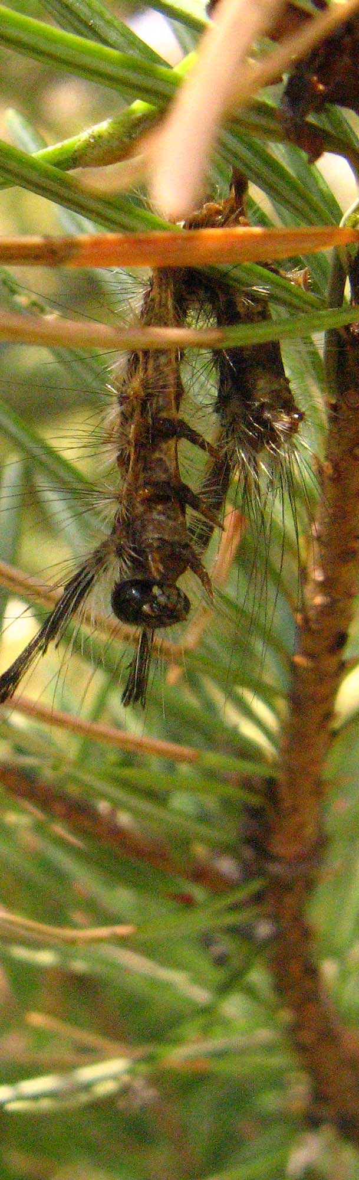
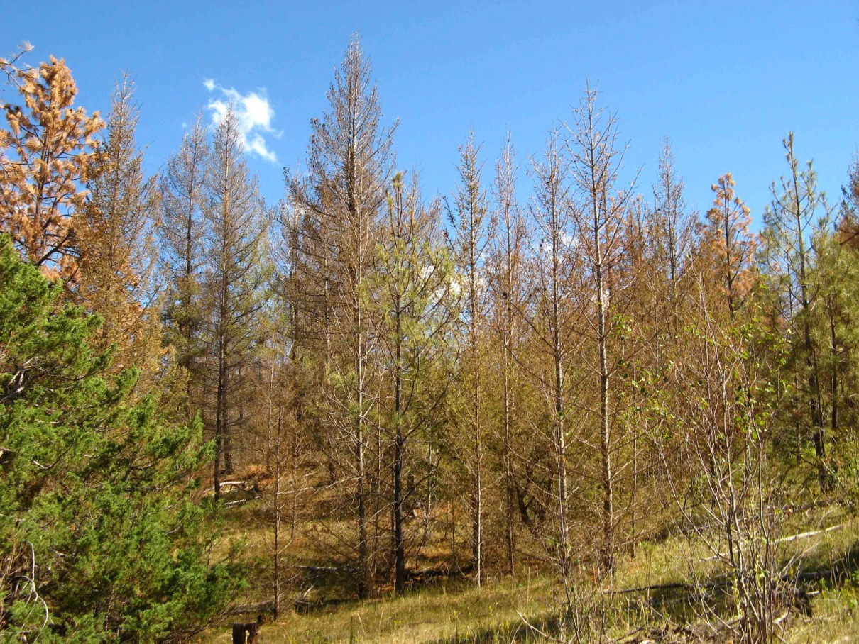
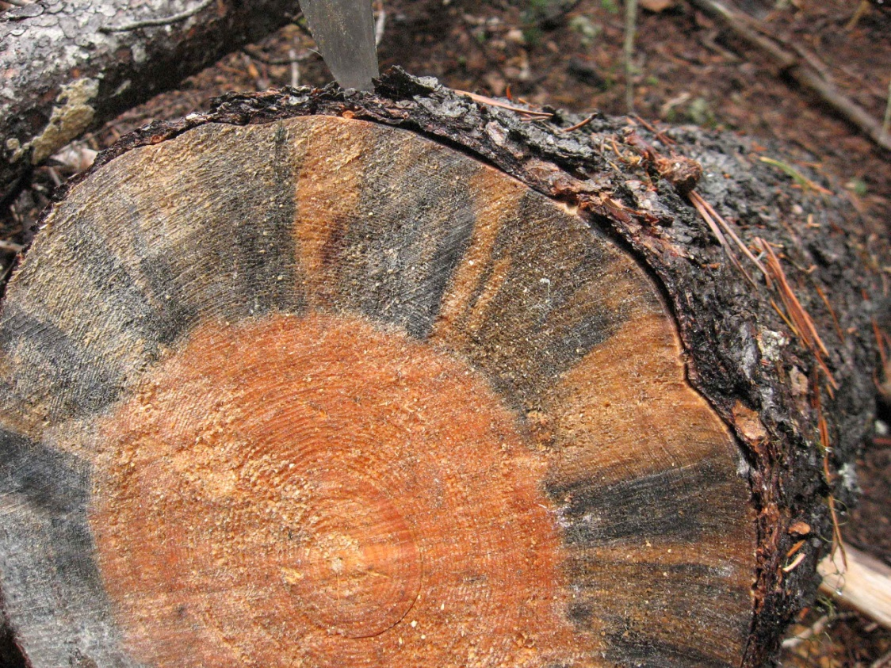
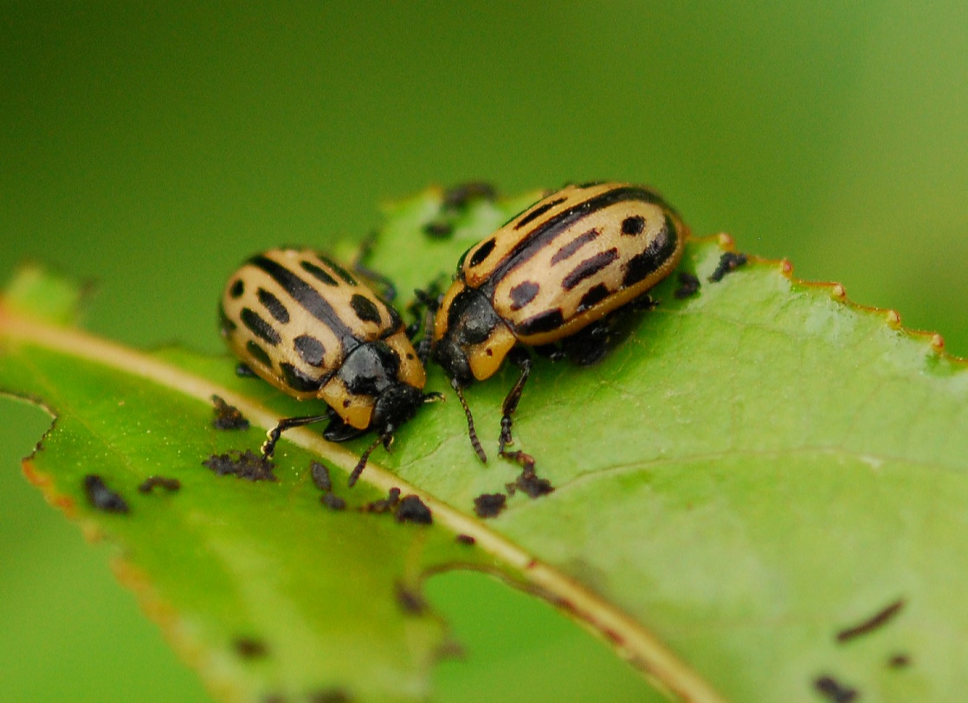
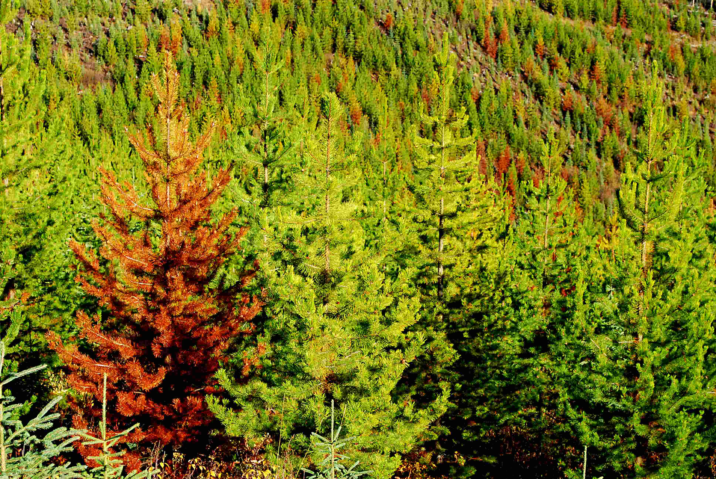
Entomology review
Kootenay Boundary Region
2013
Art Stock, Entomologist

Slide 2
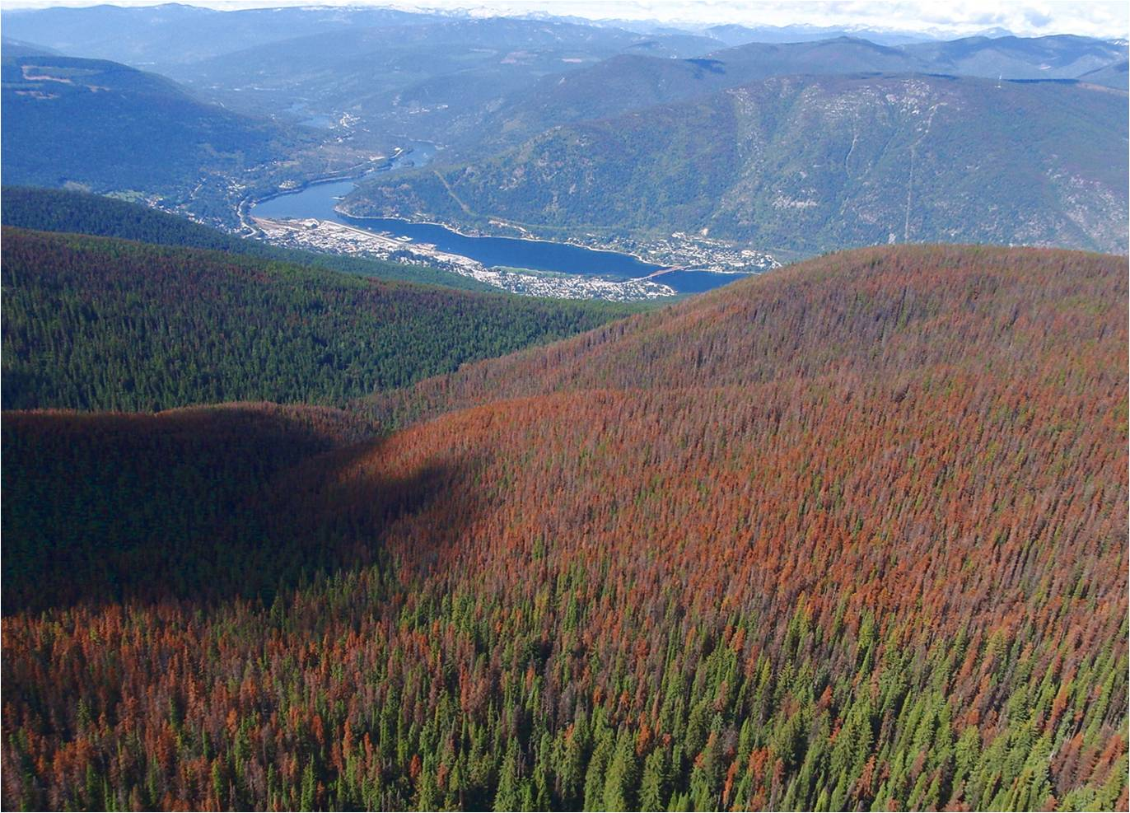
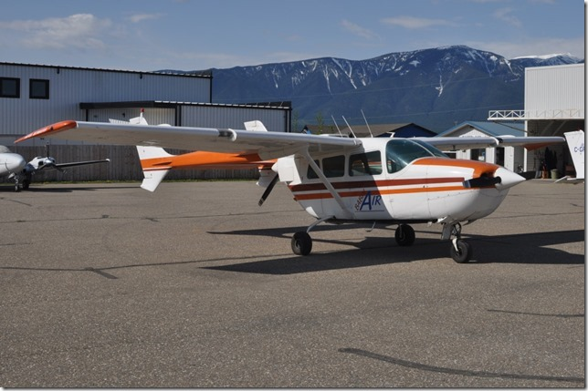
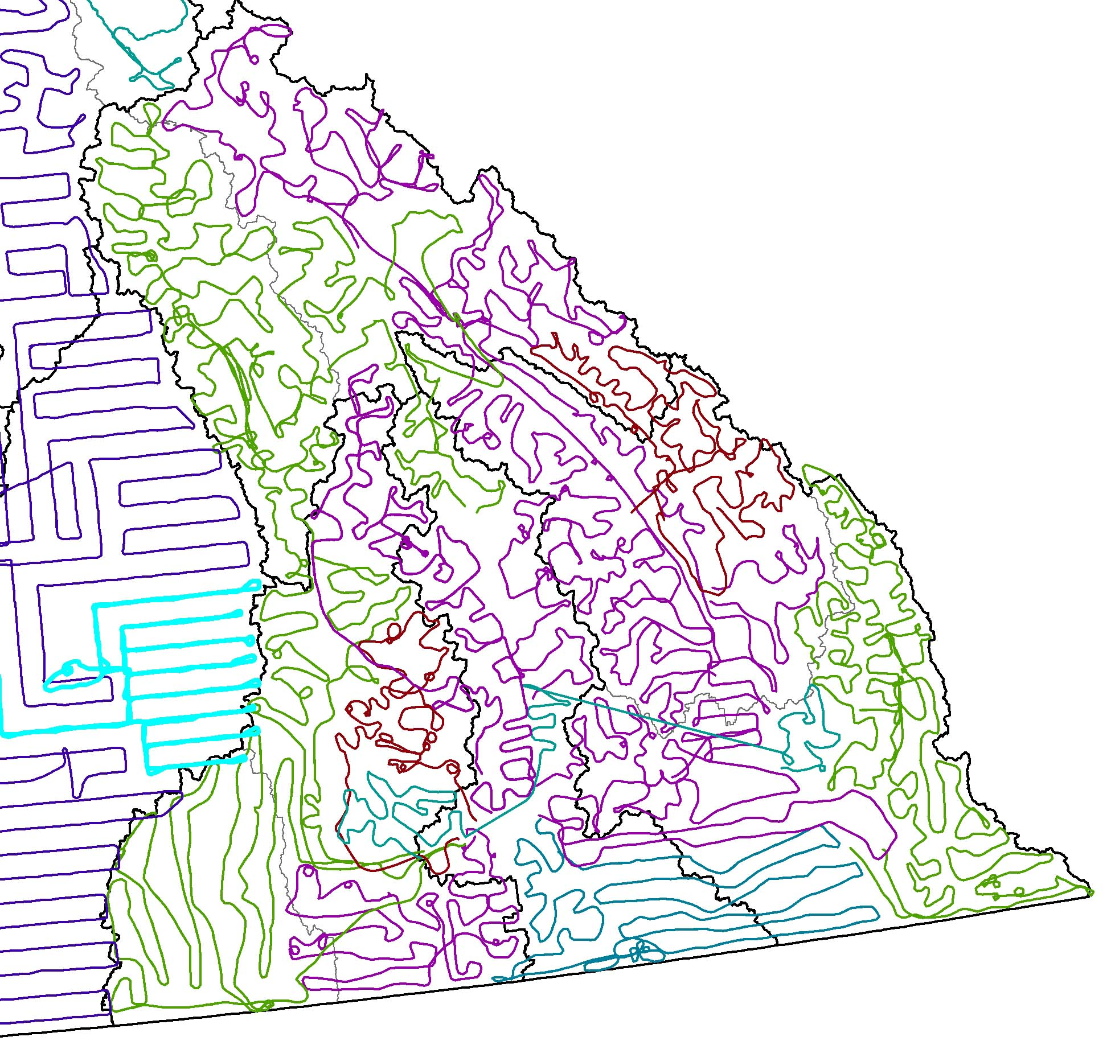
RKB Annual Overview - Aerial Survey Track, 2013
About 100 hrs flying

Slide 3
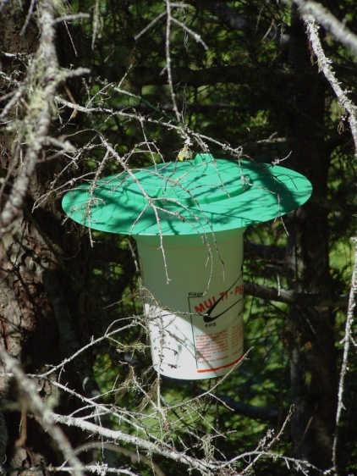
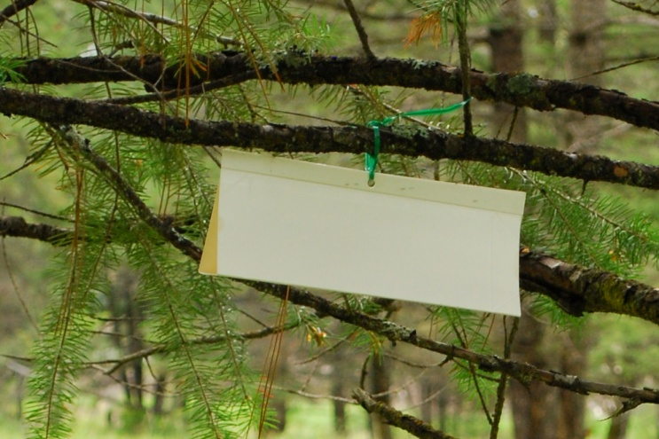
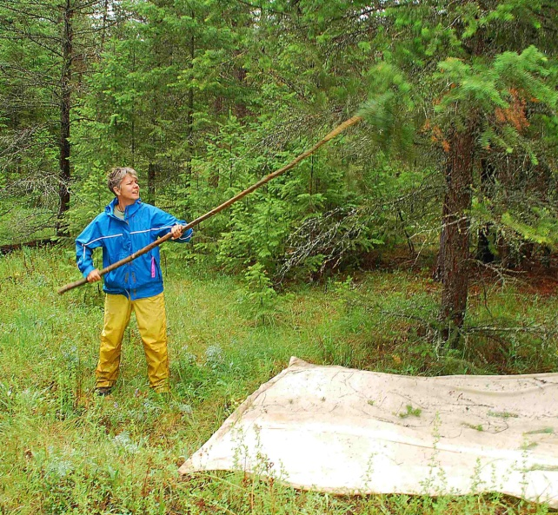
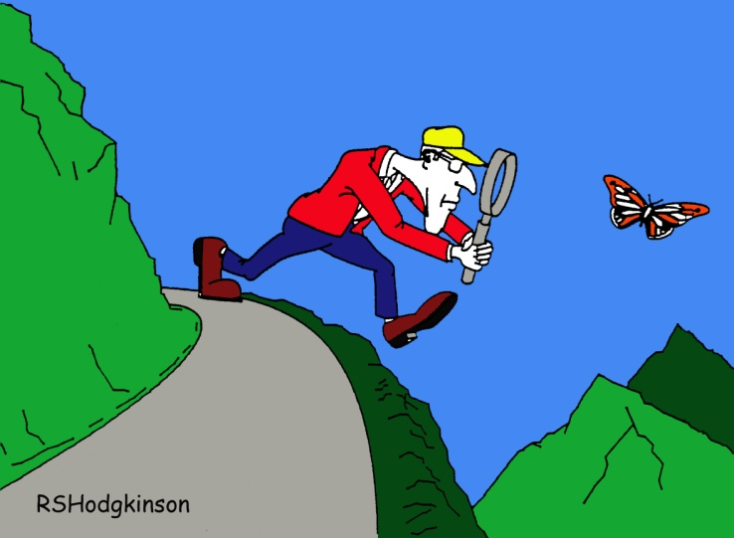
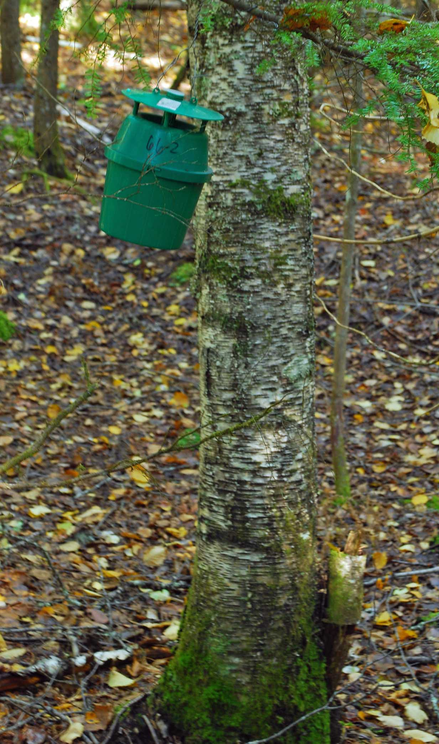
RKB Annual Overview – Ground Surveys
        Detection and monitoring of long-term population levels and trends - permanent sample sites (larvae/moths/egg masses).
Notes:
BC’s tracking/inventory systems for pest/forest damage is among the best.
Insect damage and disturbance is mapped annually and is well tailored to capturing “change” on the landscape.
BC’s tracking/inventory systems for pest/forest damage is among the best.
Insect damage and disturbance is mapped annually and is well tailored to capturing “change” on the landscape.

Slide 4
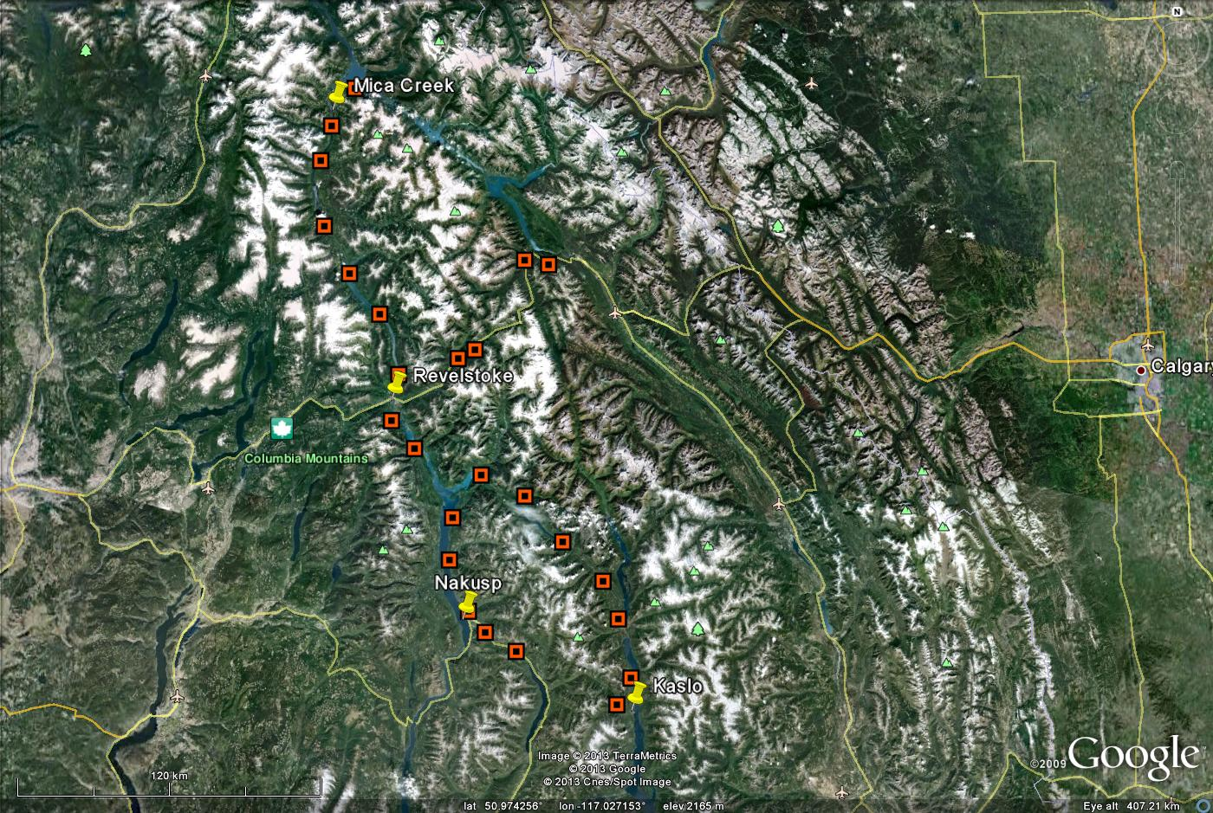
3 tree beating permanent sample sites DKL-DAB-DRE
Notes:
13 Plots in Eks, 9 plots in BO, 25 plots in RE-KL

Slide 5
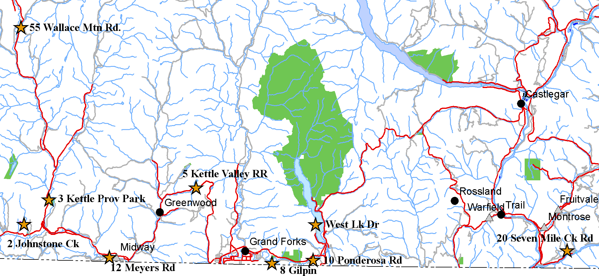
3 tree beating permanent sample sites DBO-DAB
Notes:
13 Plots in Eks, 9 plots in BO, 25 plots in RE-KL

Slide 6
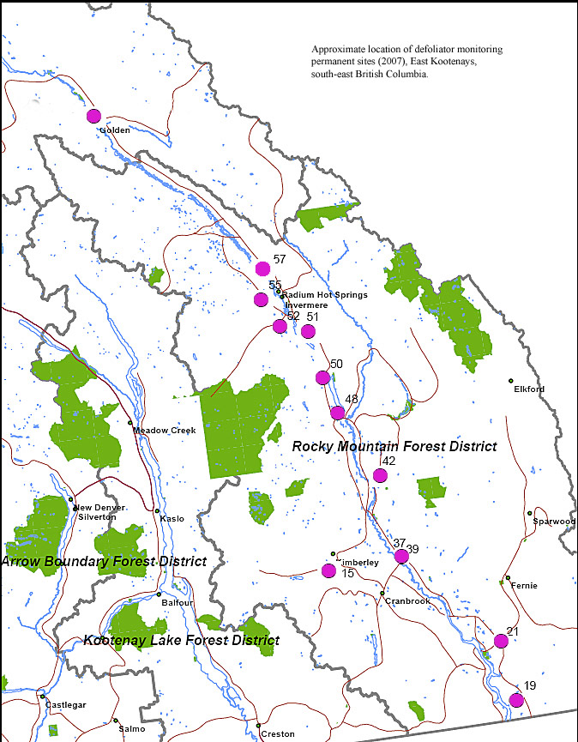
3 tree beating permanent sample sites
DRM-DIN-DGO
Notes:
13 Plots in Eks, 9 plots in BO, 25 plots in RE-KL

Slide 7
Gypsy moth permanent sample sites RKB
Rec sites, small parks, other “remote” tourist areas
Notes:
13 Plots in Eks, 9 plots in BO, 25 plots in RE-KL

Slide 8
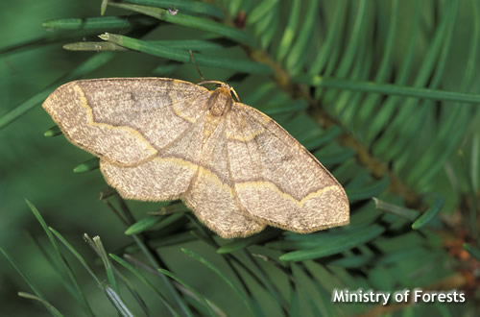
?

Slide 10
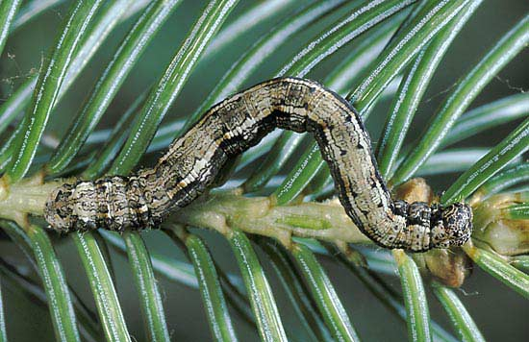
Recorded outbreaks of western hemlock looper, Lambdina fiscellaria lugubrosa, Kootenay-Boundary Region, 1937-2005.
Mica
Recorded years of defoliation
Golden
Revelstoke
Nakusp

Slide 11
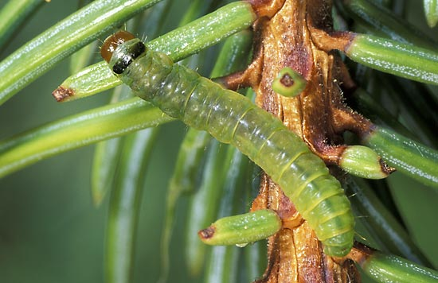

Slide 12
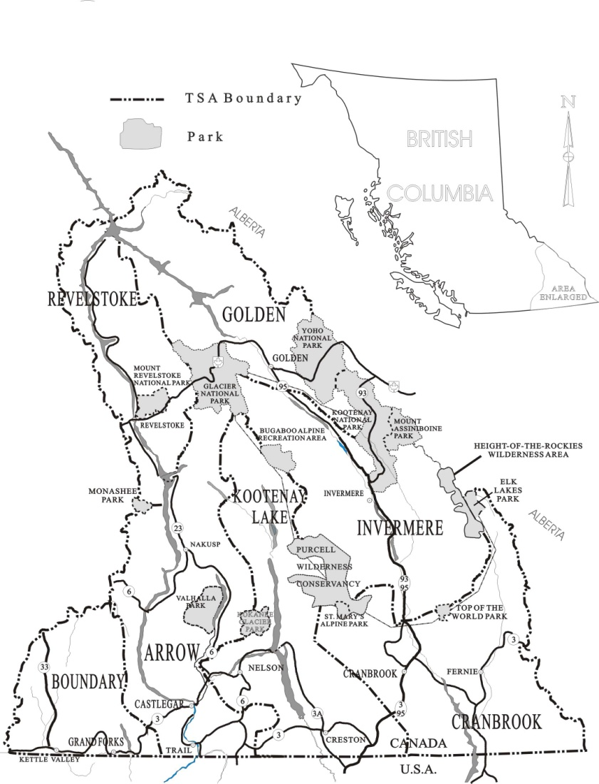
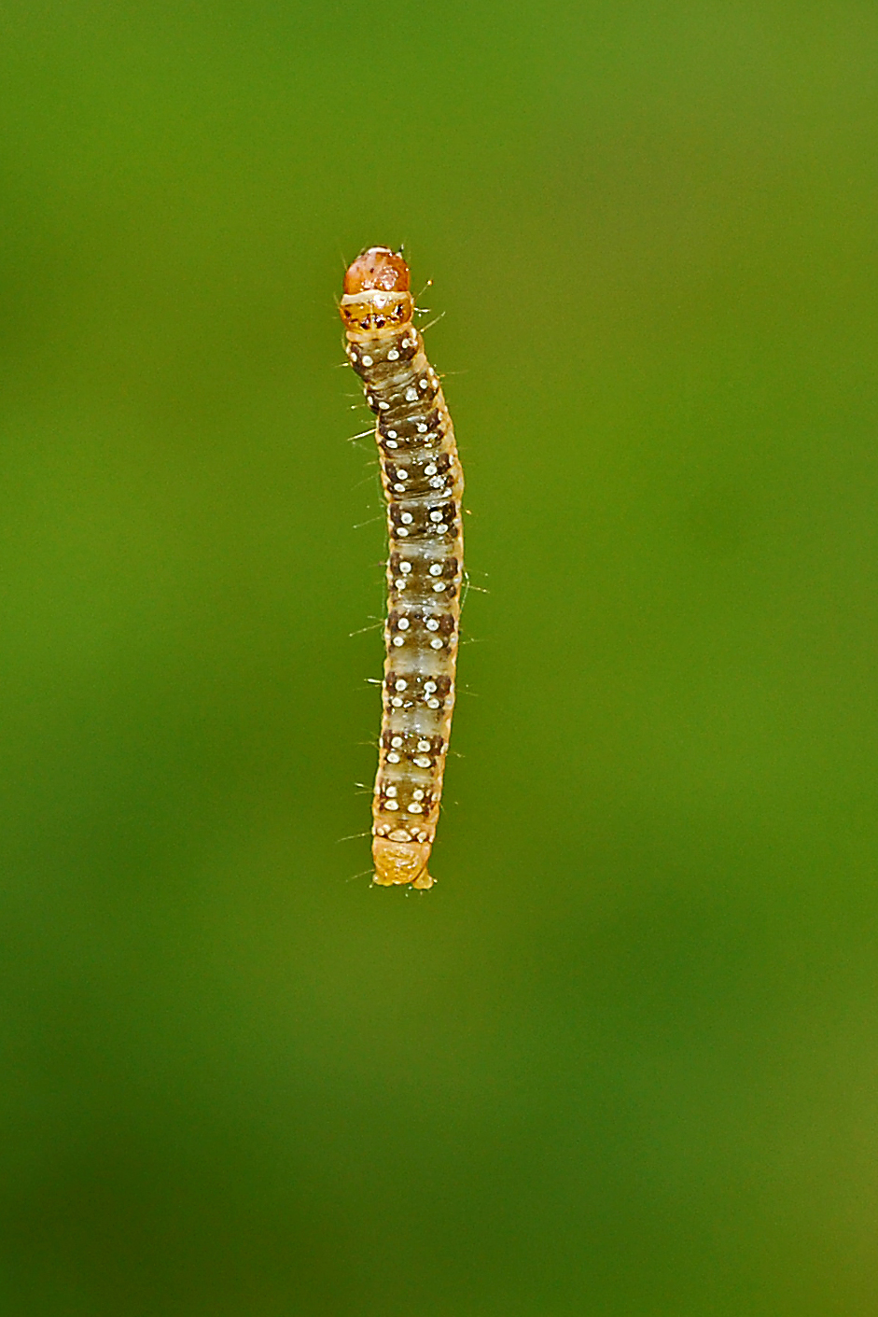
Western spruce budworm outbreaks, 1923-2013, south-east BC
1923-1928
1976-1992
2009-2012

Slide 13
History of spray operations in Kootenay-Boundary Region
Year | Insect | TSA | Ha | Insecticide^{α} | Comments
1948 | IDZ | IN | 4,500 | DDT | Christmas tree plantations
1982 | IDT | BO | 20 | Orthene | Christina Lake Golf Course
1988 | IDW | BO | 100 | Btk | Spray efficacy trial
1989 | IDW | BO | 100 | Btk | Spray efficacy trial
2003 | IDL | RE | 5,925 | Btk | Tree protection and efficacy testing for registration
2010 | IDT | BO | 165 | NPV | East of Midway, and at Rock Creek
2012 | IDW | BO | 13,675 | Btk | Protection of high value Fd polygons, and population suppression.
2012 | IDL | RE | 8,769 | Btk | Protection of mature hemlock in priority caribou habitat, and population suppression.

Slide 15
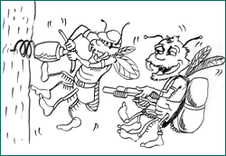

Slide 16
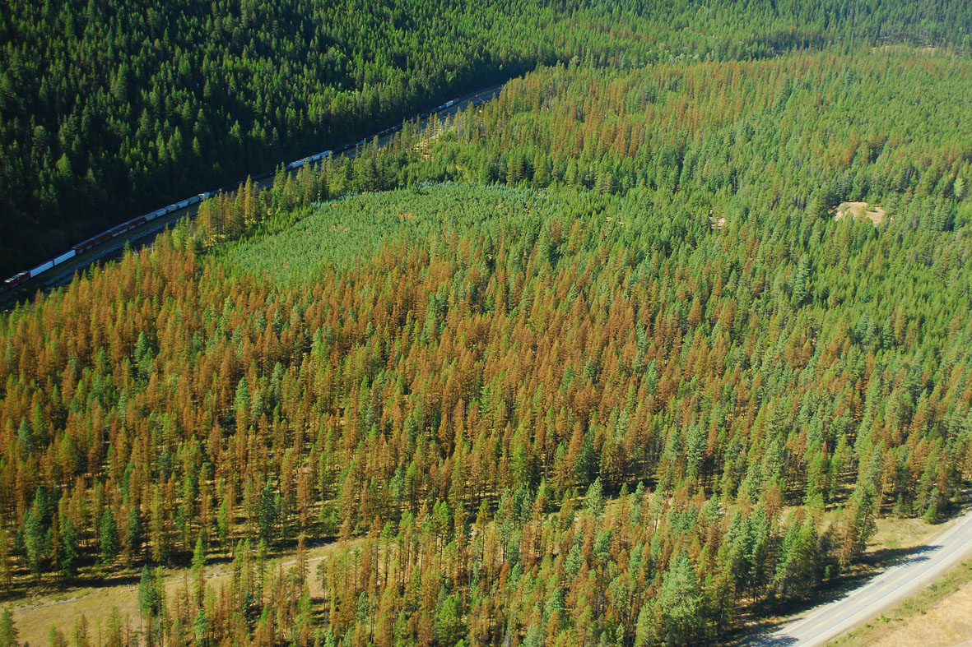
Needle blight Hypodermella laricis
Needle cast Meria laricis

Slide 17
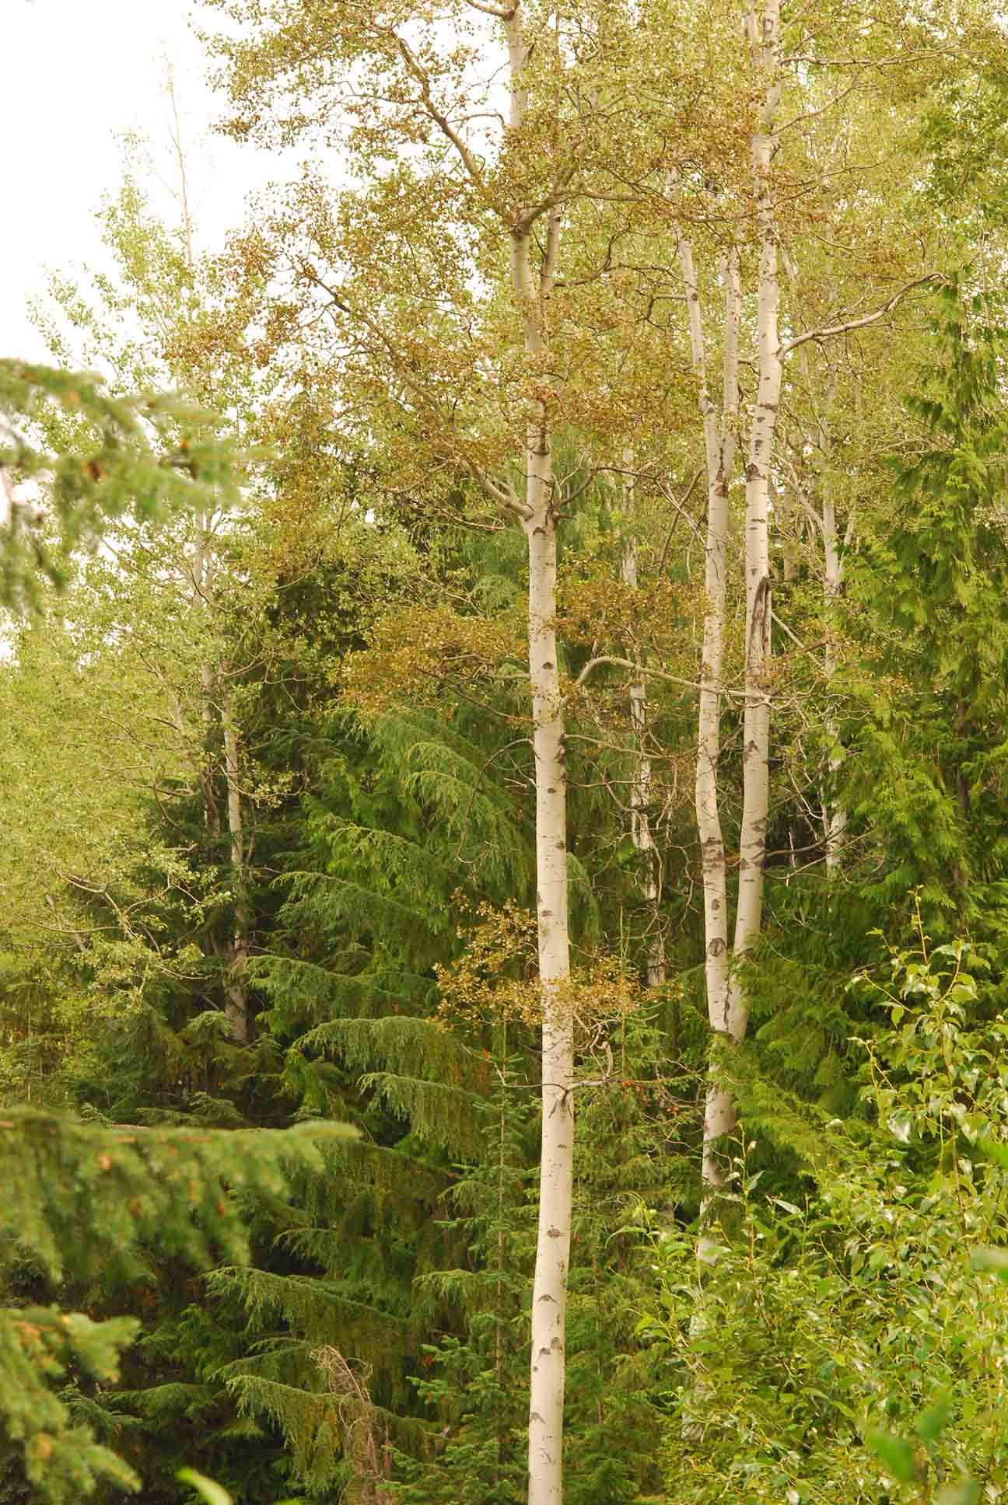
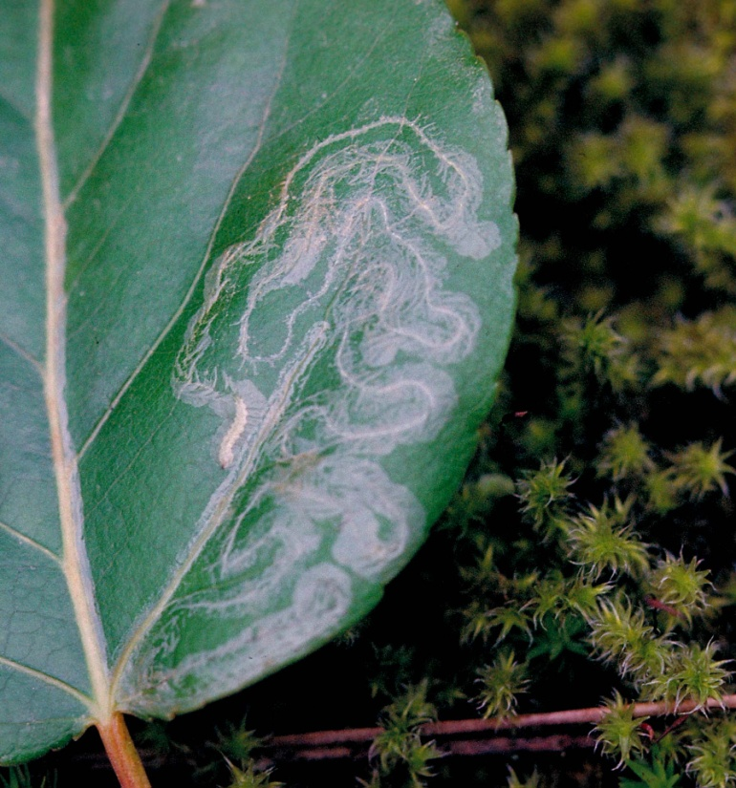
Defoliation in deciduous
Aspen leaf miner
Birch leaf miner
Cottonwood leaf beetle
Venturia leaf blight

Slide 18
Bear damage in young pine – it’s worse than it looks. ~ 350 ha in 2012.

Slide 19
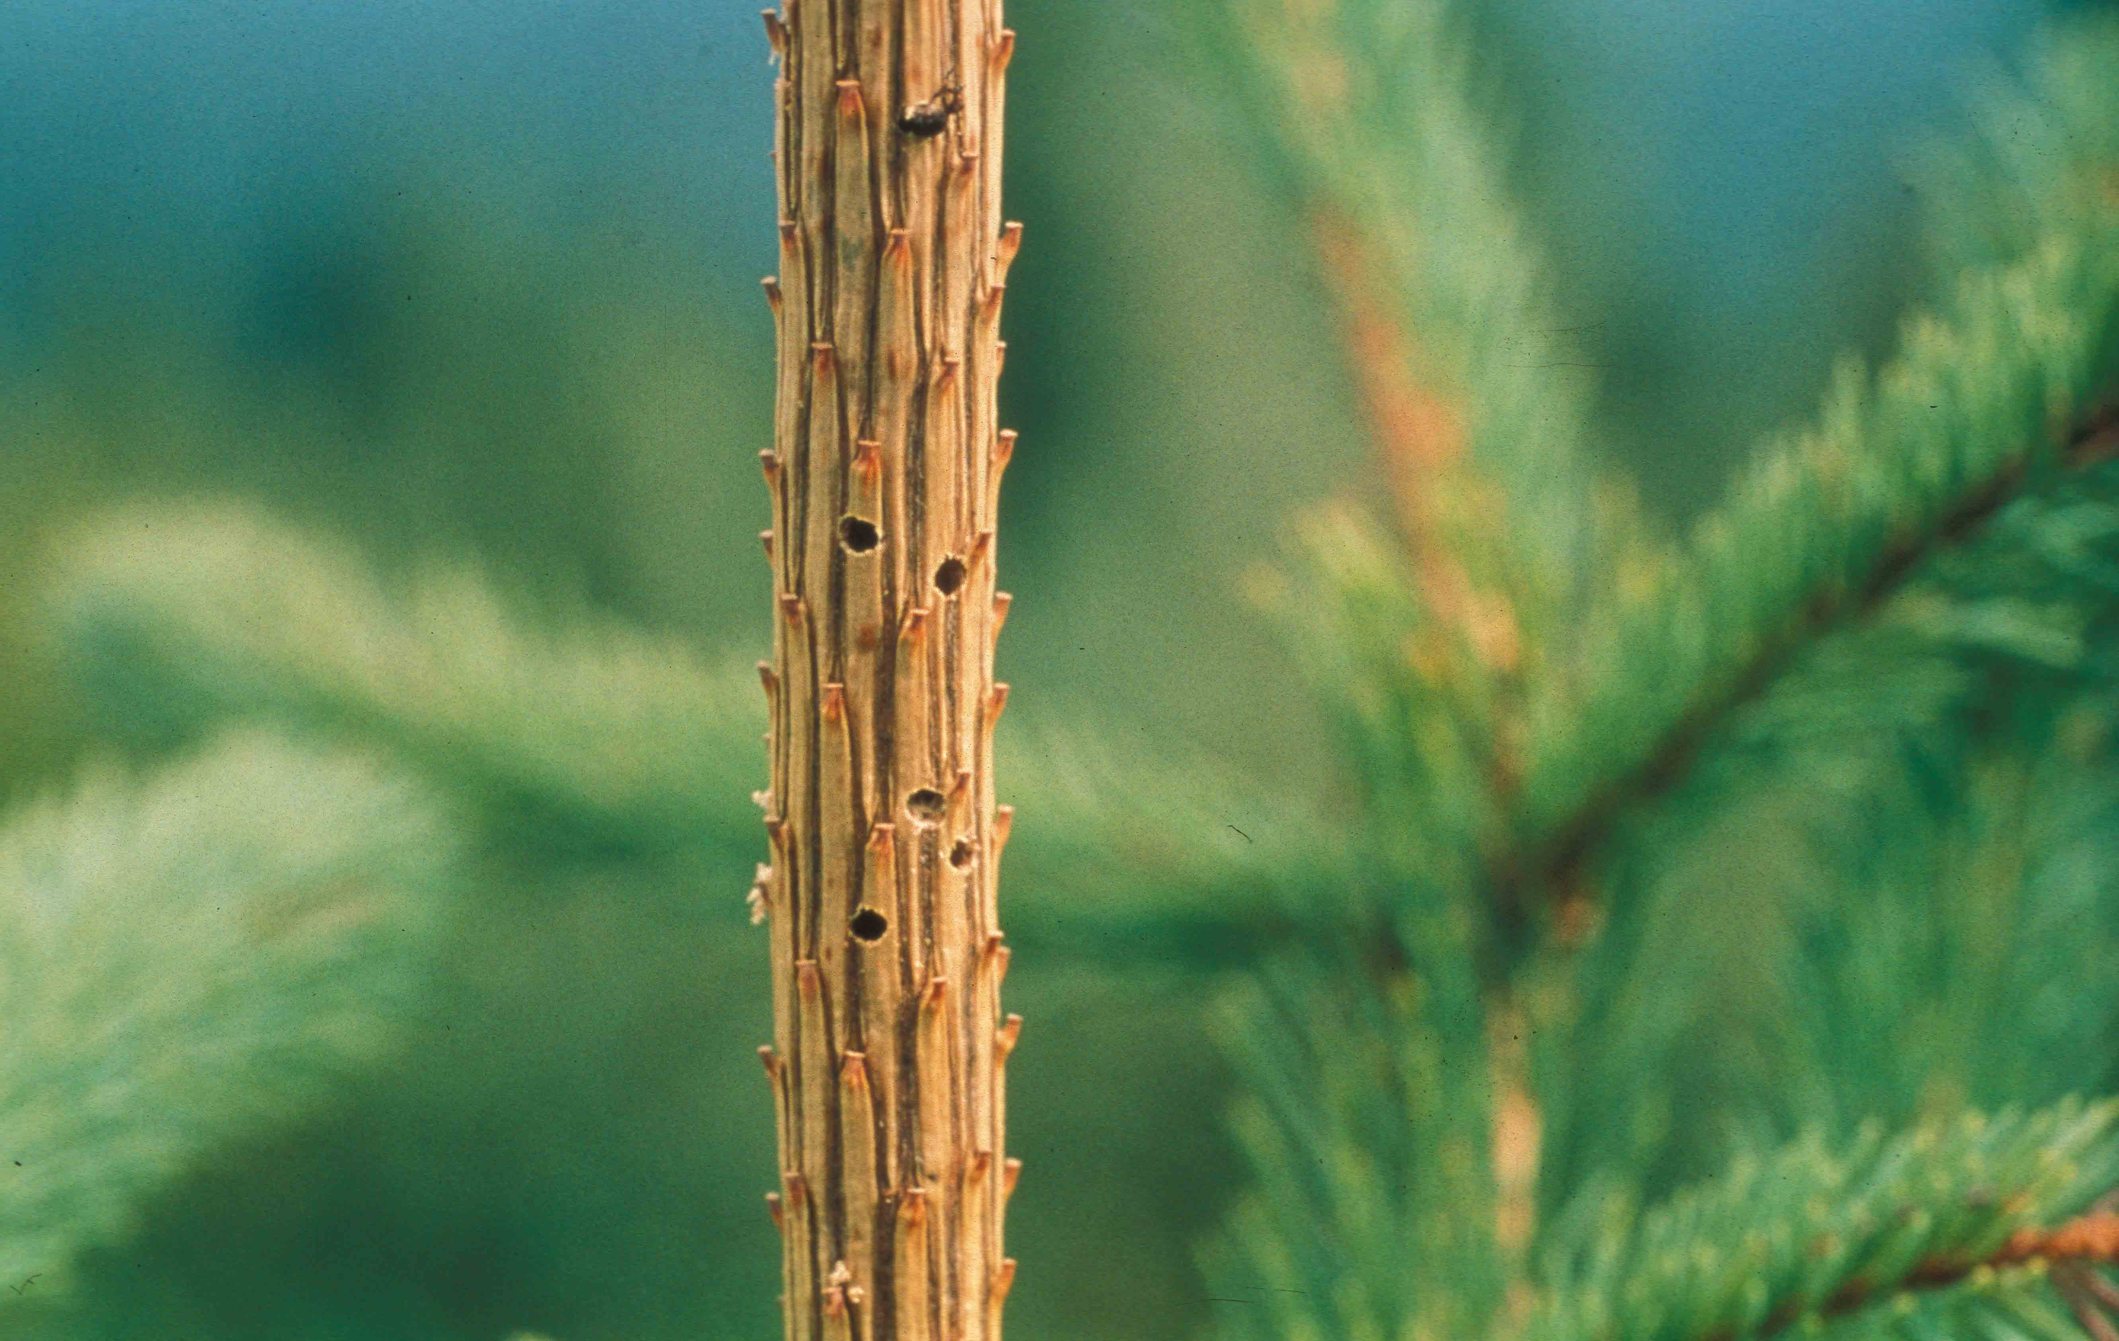
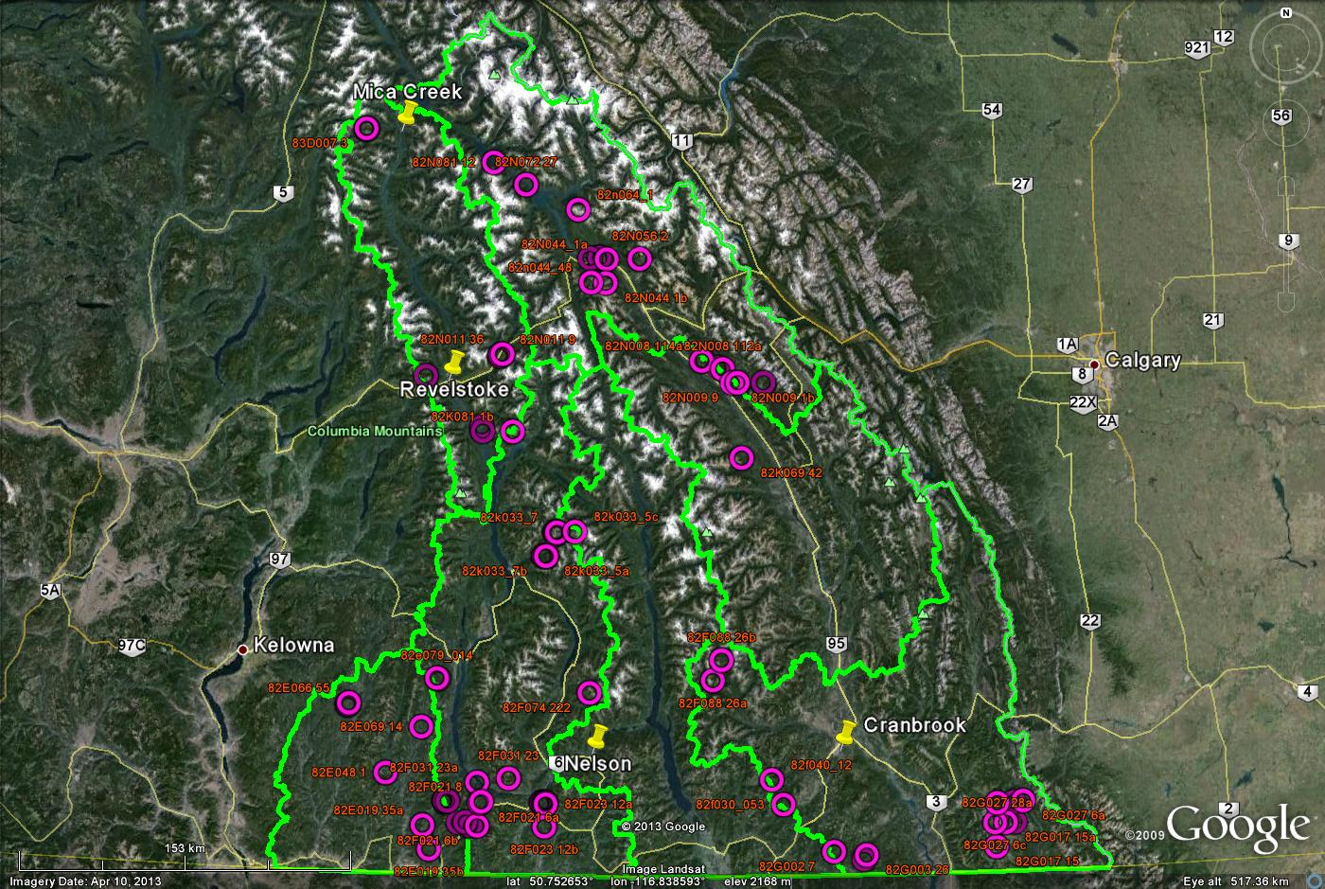
Spruce weevil assessment survey sites, 1995

Slide 20
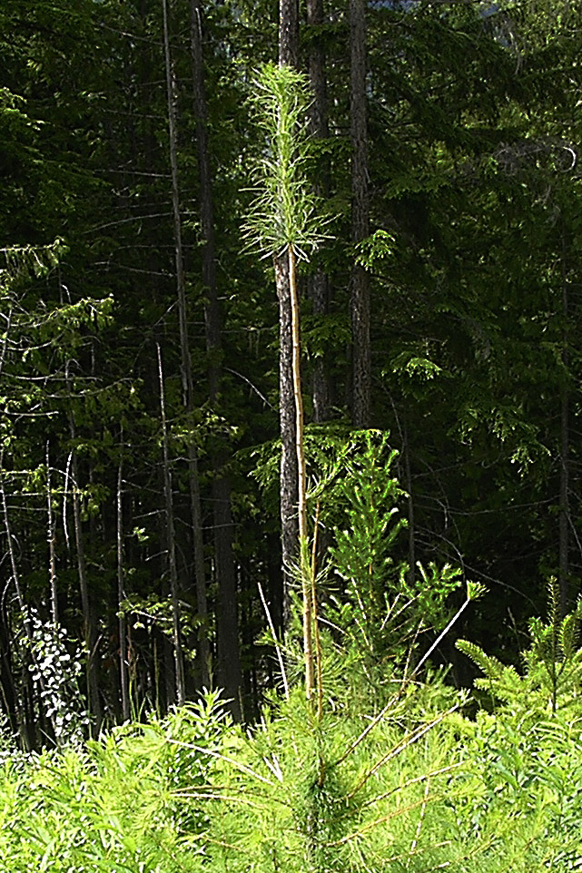
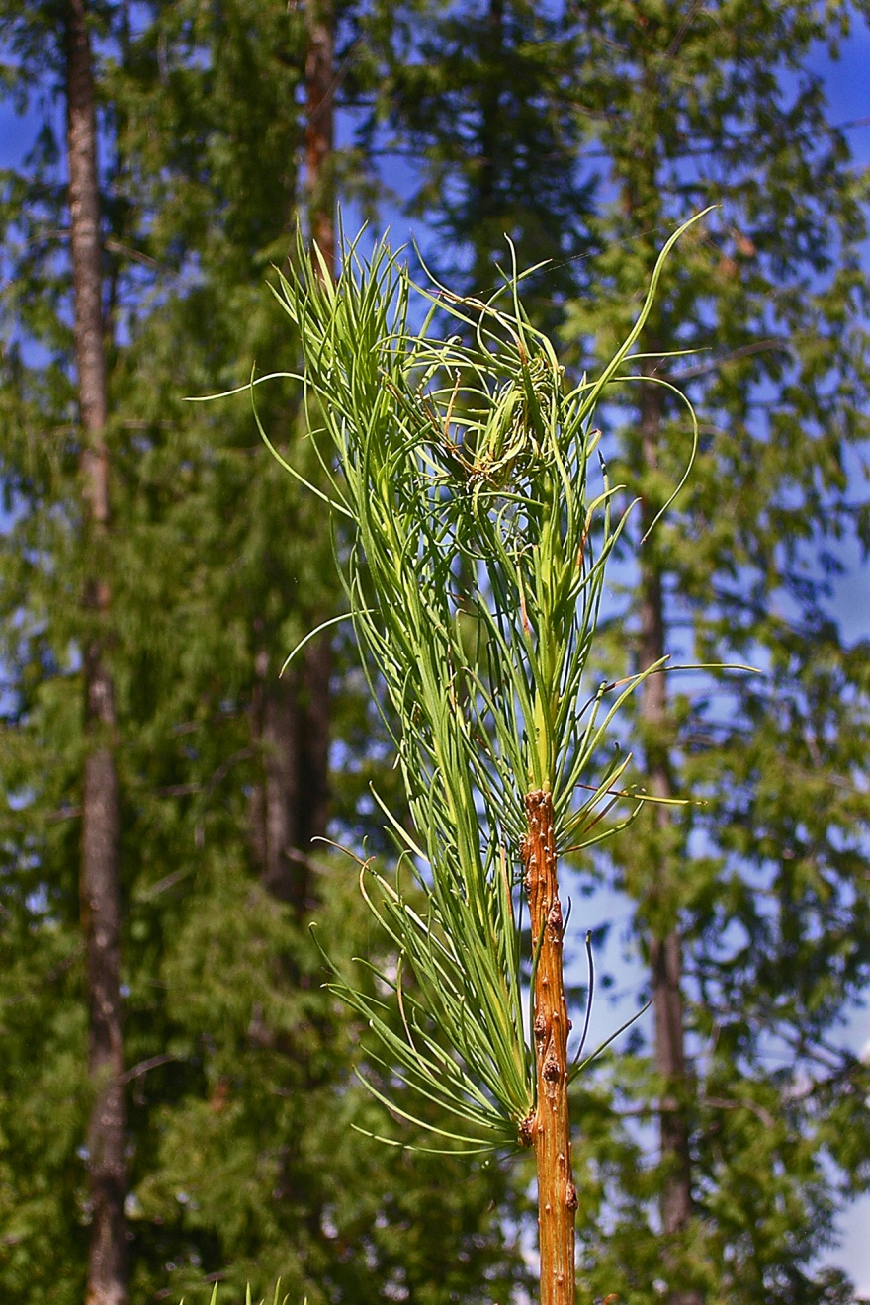
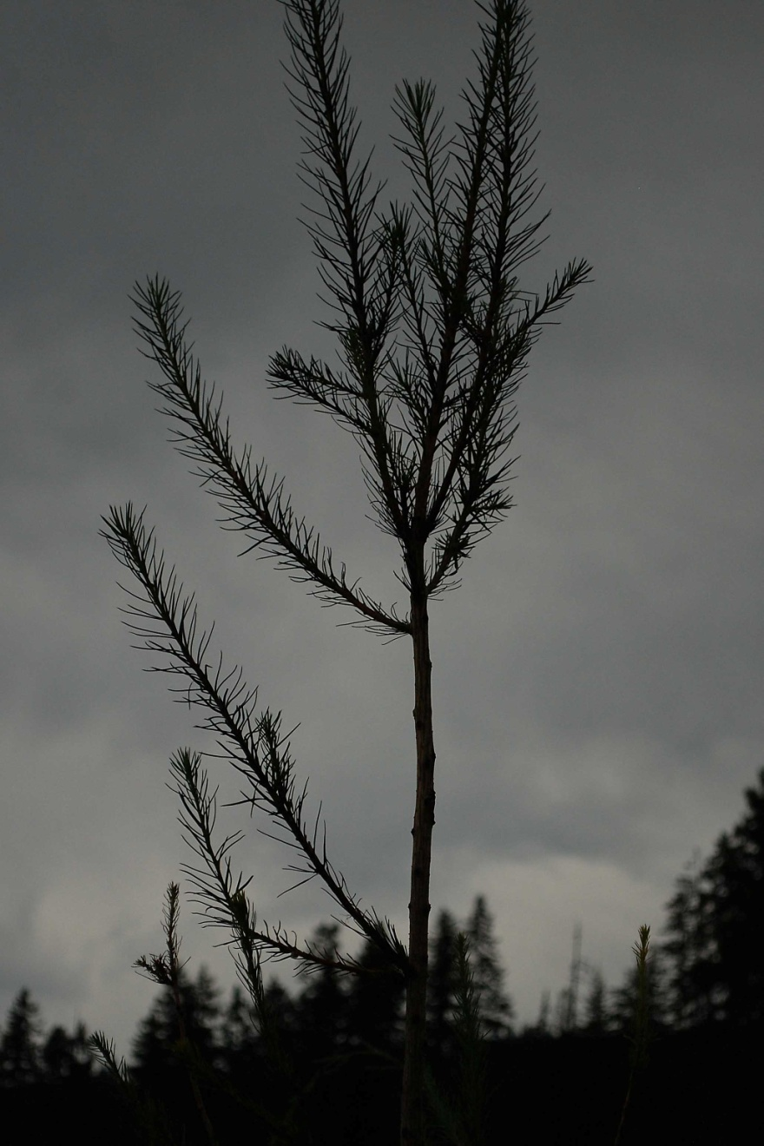
Unusual larch growth
Drought? Foliar disease? Insects? Impact?

Slide 21
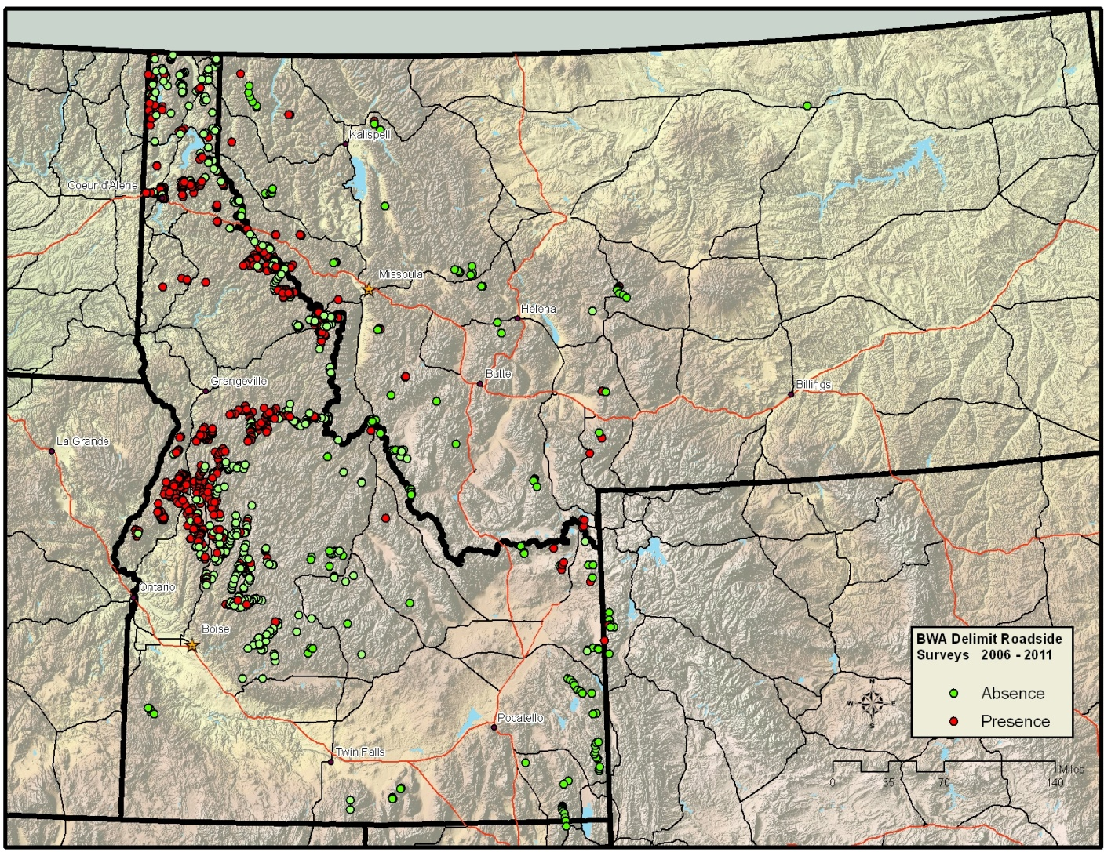
Balsam Woolly Adelgid Survey 2006-2011
1287 sites surveyed
49% of locations positive
High densities found 563 m to 2080 m
Moderate densities up to 2387 m
200 mile spread from 1998
Survival threshold mean Jan temp -11C
Bg is “resistant”? Bl is not...
Is any of this being mapped as IBB?
Courtesy Laura Lazarus
USFS, Forest Health Protection
Boise Field Office
Notes:
BWA surveying continued through 2011. A total of 1287 spots were surveyed for BWA presence since 2006 with 49% of them positive. BWA was found bordering Montana in 2010 and FHP ento, Lee Pederson, found BWA as far east as Montana in 2011. BWA spread 200 miles since the 1998 surveys, from North of salmon river to Montana and Driggs area. We did not find BWA in the Owyhees or southeast ID.
Overall, Levels of infestation varied such that we think BWA has been in some of these areas for nearly 20 years (southwestern Idaho) and some were invaded much more recently based on gouting levels. We found a significant difference between the mean elevations for BWA absence, 5875 ft and presence, 4754 ft. BWA infestations were found from 1876 to 7913 ft. High densities of BWA were found up to 6932 ft and moderate densities to 7956 ft. Gouting was found at 15 % of locations.
SAS Enterprise Guide was used to fit a multiple logistic model for bwa presence/absence, variables were aspect, slope and elevation. The generalized R² of .2375 is not great, but indicates some predictive power for the 3 variable model (Regional statistician). All the variables of susceptibility are still unknown.

Slide 22
Key issues going forward
Climate change
  Pest range changes, host-pest interactions on margins, outbreak intensities, outbreak cycles.
  Severe weather disturbances.
Invasives
  Monitor, expect the unexpected.
Social objectives
  The best available management tools are useless without the will to use them in a uniform effort over time and space.

Slide 23
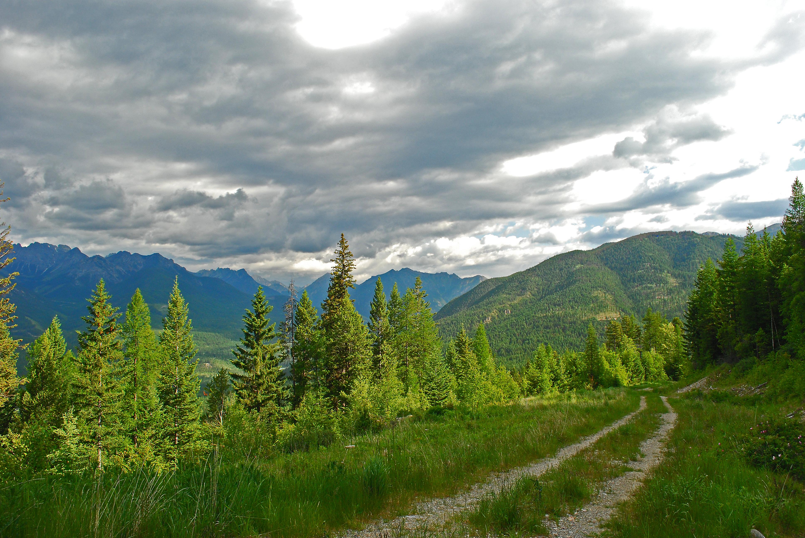
?’s

